Slide 1

Super-Store
The Main objective of
this project is to analyze
Sales data to gain
actionable insights that
Will enhance the
performance of the
Super Store.

Slide 2

Recommended Analysis
1. Which are the top 3 states contributing to the sales? 2. Which Sub-category is getting highest sales ? 3. The count of customers incresing or decreasing ? 4. In which month we are getting highest sales? 5. Which channel had the highest sales contribution?

Slide 3
Key Insights :-
The top 3 states contributing to sales are California, New York, Texas.
The sales are high in the month of November, September.
In the category of technology phones are contributed the most to sales.
The Count of customers in 2020 was 595 and which is increased to 693 in the year 2023.
In the Field of technology the store getting the highest sales in the every year.

Slide 4
Conclusion of the Analysis :-
1. Focus more on technological field from the state like California, New York, Texas for marketing. 2. Implementing distinct sales, advertisements and coupons during the month of February could prove beneficial in boosting sales and enhancing customer engagement. 3. Improve order status for better customer satisfaction and efficiency.

Slide 5
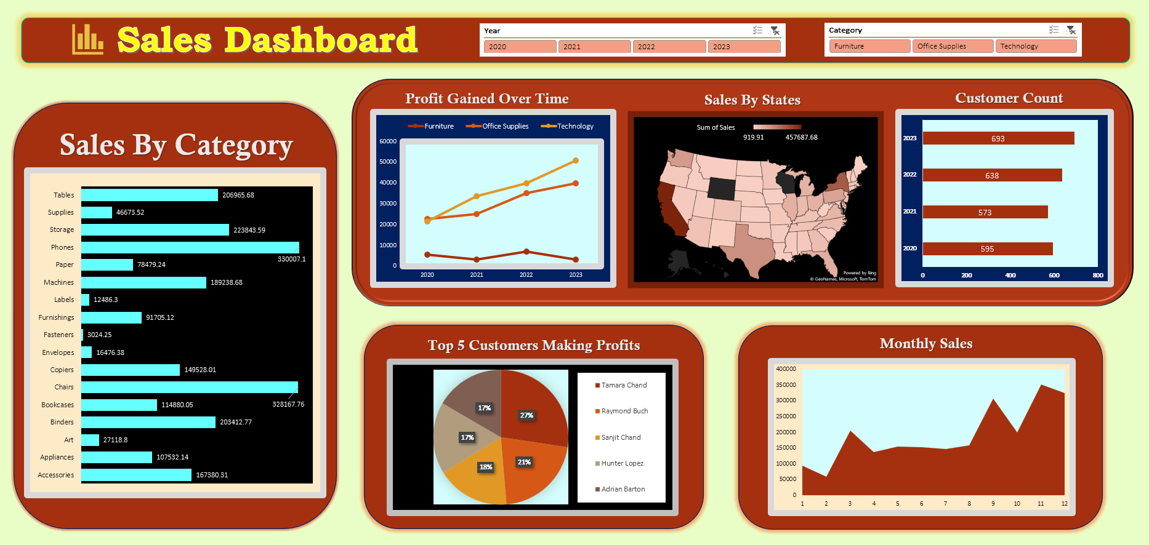
Dashboard

Slide 6
THANK YOU

